Slide 1
How To Write a Strong Thesis

Slide 2
Writing a Thesis
A thesis is the argument you are making in your paper.
Benefits
Allows reader to clearly see topic of paper
Allows author to keep research focused

Slide 3
Step One
Start with a question

Slide 5
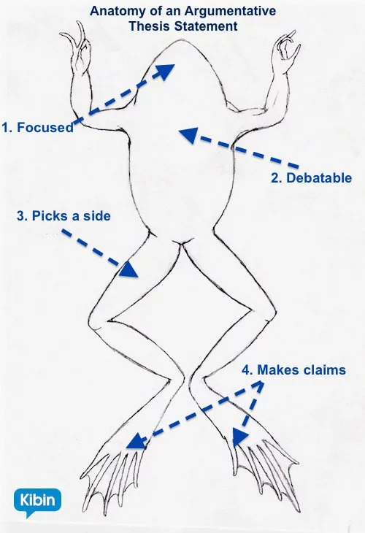
Step Two
“Americans should eliminate the regular consumption of fast food because a fast food diet leads to preventable and expensive health issues, such as diabetes, obesity, and heart disease.”
“Although the 1st World War used to have various
causes, burgeoning nationalism formed the sense
of hatred that provoked the War’s start and proliferation.”
The invention of the steam engine changed the landscape of America, allowing people to travel further than they ever had before and speeding the settlement of the frontier.
Tailor thesis to type of paper you are writing
Argumentative
Makes a claim and then backs it up
Analytical
Makes something easier to understand
Expository
Teachers or illustrates a point

Slide 7
Step Three
Take a specific stance
Debaters mindset 101
Why?
Allows for a stronger thesis

Slide 9
Step Four
Ensure you can prove your thesis
Be objective, not subjective
Objective is fact based
Subjective is opinion based

Slide 11
Step Five
State your thesis correctly
Thesis should serve as a roadmap to your paper
Remember
A good thesis is an argument
Specific
Not an observation or fact

Slide 13
Step Six
Make it stand out
But not literally
A good thesis is easy to recognize

Slide 15
Step Seven
Keep it short
A good thesis is 1-2 sentences
If it’s longer, redo it

Slide 17
Step Eight
Make sure your topic is specific enough.
Make sure your topic has enough information to answer

Slide 18
Step Nine
Follow the blueprint
Clearly state the topic or subject
Summarize what you are going to say
Examples
[Something] [does something] because [reason(s)].
Because [reason(s)], [something] [does something].
Although [opposing evidence], [reasons] show [Something] [does something].

Slide 19
[Something] [does something] because [reason(s)].
Because [reason(s)], [something] [does something].
Although [opposing evidence], [reasons] show [Something] [does something].

Slide 20
Step Ten
Write it down and ask yourself
Is it a question?
Is it a list?
Is it off topic?
Is it in first person?
Is it combative?
If you answered yes to any of the above, you need to rewrite your thesis.

Slide 21
Things to Remember
Never use first person
“I believe that dogs are better than cats because they’re loyal, they provide protection, and they can be used for recreation.”
Good or bad?
BAD,
Can you fix it?
“Dogs are better than cats because they’re loyal, they provide protection, and they can be used for recreation.”

Slide 22
Things to Remember
Avoid
In this paper….
This paper will be about…
I will be talking about

Slide 23
YOUR TURN!
Log on to Google Classroom
Click on the assignments tab
Go to link titled “creating a thesis”
Create a thesis
Before submitting ask yourself the special questions
When all is good, click turn in

