Slide 1
Writing Analysis
Matthew Q. Larson

Slide 2
What is Analysis?
Analysis is a chance to explain why the evidence given is important
Lets you put evidence in context
Explains
What evidence means
How it connects to the prompt

Slide 3
Analysis v. Summary
Not the same!
Summary simplifies the ideas
Analysis relates it to you
Takes it deeper
Source: https://writingcenter.uagc.edu/summary-vs-analysis

Slide 4
Analysis v. Summary
Source: https://writingcenter.uagc.edu/summary-vs-analysis

Slide 5
Steps to Analysis
Find the topic
Break topic into multiple parts
Example
Social Impact
Economic Impact
Setting
Source: https://writingcenter.uagc.edu/summary-vs-analysis

Slide 6
Steps to Analysis
Note connections
Ask questions
WHY
Why is this effective?
HOW
How does this relate to other parts?
Pull in outside information
Source: https://writingcenter.uagc.edu/summary-vs-analysis

Slide 7
Steps to Analysis
Draw a conclusion
What connections have YOU found?
This will be the analysis
Source: https://writingcenter.uagc.edu/summary-vs-analysis

Slide 8
What analysis isn’t
Restating of the evidence
Prompt: “Santa Clause is real”
Evidence: Mountains of historical data and more than 50 years of NORAD tracking information leads us to believe that Santa Claus is alive and well.
Analysis: NORAD has been tracking Santa for over 50 years. Because they have lots of information, we know that Santa is alive and well.
Source: https://writingcenter.uagc.edu/summary-vs-analysis

Slide 9
Summary or Analysis?
SUMMARY
Source: https://writingcenter.uagc.edu/summary-vs-analysis

Slide 10
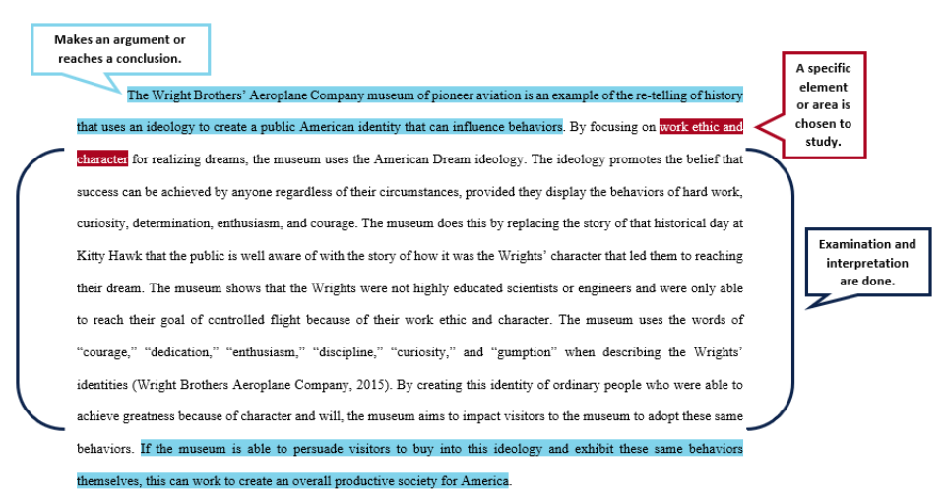
Summary or Analysis?
ANALYSIS
Source: https://writingcenter.uagc.edu/summary-vs-analysis

Slide 11
Summary or Analysis?
This quotation comes from Freud's Civilization and its Discontents. Here, Freud implies that man will only be happy when living according to the pleasure principle. The pleasure principle leads people to do or desire things that bring them pleasure. Freud presents a good point here, and he uses many examples throughout the text to support it.
ANALYSIS
Source: http://writing2.richmond.edu/writing/wweb/trans1.html

Slide 12
Summary or Analysis?
This quotation contains a central concept of Freud's psychology: humans are driven by the pleasure principle and are most happy when fulfilling its demands. As Freud notes elsewhere in the text, the ego and superego play the roles of watchdogs, keeping the demands of the pleasure principle in check through the moderating influences of experience (Freud's reality principle) and morality. For Freud, this battle within the personality gets reflected in a society. The society passes laws that limit our freedom, and therefore our happiness, but encourage order and morality. Freud notes that the exchange of happiness for security is, in the end, worthwhile and necessary to maintaining a civilization.
SUMMARY
Source: http://writing2.richmond.edu/writing/wweb/trans1.html

